Slide 1


Machine Learning & Research Webinar
For Future DEV
Presented by Md. Shariar Emon Shaikat, BRAC University

Slide 2


Python
Let’s Start

Slide 3
AGENDA OVERVIEW
Navigating the World of ML Research
01
02
Introduction & Objectives
Core ML Concepts & Research
Setting the stage for our ML journey.
Understanding the fundamentals and research landscape.
03
04
Latest Models & Trends
Hands-on Example / Demo
Exploring the cutting edge of AI and ML.
Bringing theory to life with practical application.
05
06
Research Skills & Tips
Q&A Session
Equipping you for your own ML research endeavors.
Your opportunity to ask questions and engage.
1
Life is not Easy

Slide 4

FUNDAMENTALS
Understanding Machine Learning
Machine Learning (ML) is a subset of Artificial Intelligence (AI) that focuses on enabling systems to learn from data, identify patterns, and make decisions with minimal human intervention. It's distinct from broader AI which encompasses any technique that enables computers to mimic human intelligence, and Deep Learning, a specialized form of ML using neural networks with multiple layers.
Artificial Intelligence
Systems that simulate human intelligence
Machine Learning
Algorithms that learn from data
Deep Learning
Neural networks for complex pattern learning
ML's importance is growing across every industry, driving innovation and efficiency in diverse real-world applications.
2
keep going anyway

Slide 5




APPLICATIONS
ML in the Real World
Healthcare
Finance
Natural Language Processing (NLP)
Computer Vision
Disease prediction, medical imaging analysis (e.g., COVID-19 X-ray analysis).
Fraud detection, algorithmic stock market prediction, risk assessment.
Self-driving cars, facial recognition (YOLOv8, SAM), object detection.
Chatbots (GPT, ChatGLM), language translation (mBART, M2M-100).
3
Struggle today

Slide 6
RESEARCH FOCUS
What is Machine Learning Research?
ML research delves into advancing the field by developing new algorithms, improving existing models, and exploring novel applications. It's a critical distinction from mere development, which focuses on implementing existing solutions.
Research
Development
Focused on generating new insights, conducting experiments, and pushing the boundaries of what's possible.
Aims to create production-ready implementations of existing or well-understood ML techniques.
4
Strength tomorrow

Slide 7






PROCESS
The ML Research Workflow
Problem
Literature
Dataset
Model
Evaluate
This systematic approach ensures rigorous exploration and validation of hypotheses, leading to meaningful contributions to the field.
5
Stay patient

Slide 8






FOUNDATIONAL CONCEPTS
Key Pillars of Machine Learning
Supervised Learning
Unsupervised Learning
Reinforcement Learning
Learns from labeled data to make predictions or classifications.
Discovers patterns or clusters in unlabeled data without prior knowledge.
An agent learns to make optimal decisions through trial and error, based on rewards.
6
Life is shaping you

Slide 9
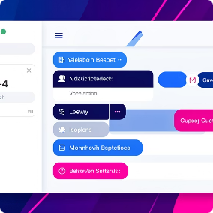



CUTTING EDGE
Latest Models & Trends in ML/AI
NLP Breakthroughs
Computer Vision Evolution
Multimodal AI
Reinforcement Learning Advancements
Models like OpenAI's GPT-4 multimodal and BLIP-2 seamlessly integrate various data types, pushing AI's perceptual abilities.
Advanced models like GPT-4/GPT-4o, LLaMA 3, and Mistral 7B are redefining language understanding and generation.
Innovations such as SAM (Segment Anything Model), YOLOv8, and DINOv2 offer unparalleled image analysis capabilities.
MuZero and Decision Transformers are leading the charge in intelligent agent development and complex problem-solving.
7
It’s a lesson

Slide 10

TECHNIQUES
Common Machine Learning Algorithms
Linear/Logistic Regression: Simple yet powerful for predicting continuous values or classifying categories.
Decision Trees/Random Forest: Tree-like models used for classification and regression, robust to complex relationships.
Support Vector Machines (SVM): Effective for high-dimensional data, finding optimal boundaries between classes.
Neural Networks: Inspired by the human brain, these deep learning models excel at pattern recognition in vast datasets.
8
Growth leads life

Slide 11

PERFORMANCE METRICS
Evaluating ML Model Performance
Overfitting vs. Underfitting: Understanding when a model is too complex (overfit) or too simple (underfit) for the data.
Accuracy, Precision, Recall, F1 Score: Key metrics to assess a model's correctness and effectiveness, especially in classification tasks.
Train/Test Split & Cross-validation: Essential techniques to ensure model generalization and prevent bias.
Visualizing the difference between an ideal fit and an overfitted model.
9
Have Tough Mindset

Slide 12






LOOKING AHEAD
Future of ML & Research Opportunities
Machine Learning is an ever-evolving field, constantly pushing the boundaries of what's possible. The next frontier of innovation is already taking shape, driven by several key emerging trends that promise to reshape industries and create new research avenues.
Federated Learning
Explainable AI (XAI)
Edge Computing
Enabling collaborative model training on decentralized data sources while preserving privacy and minimizing data transfer.
Developing methods to make AI decisions understandable, transparent, and trustworthy for human users and regulators.
Bringing ML models closer to data sources at the network edge for real-time processing, reduced latency, and enhanced security.
Quantum Machine Learning
AutoML
Leveraging quantum mechanics to develop more powerful and efficient ML algorithms for complex, large-scale computational problems.
Automating the end-to-end process of applying machine learning, from data preparation and feature engineering to model selection and deployment.
Research & Career Prospects
These emerging areas open vast opportunities for groundbreaking research, leading to innovations in healthcare, sustainable energy, finance, and beyond. Graduates skilled in these domains will find themselves at the forefront of technological advancement, with roles ranging from AI Ethics Specialists to Quantum Machine Learning Engineers.
10
Quitting is harder

Slide 13
REAL-WORLD EXAMPLE
Case Study: Building an ML Model
Let's walk through a practical example of building a machine learning model from conception to deployment. For this case study, we'll focus on a common image classification task: distinguishing between images of cats and dogs.
1. Define the Problem
Clearly state the objective: to build a model that can accurately classify unseen images as either a "cat" or a "dog".
2. Data Collection
Acquire a large and diverse dataset of labeled cat and dog images. This might involve downloading public datasets or collecting new images.
3. Data Preprocessing
Clean and prepare the data. This includes resizing images to a uniform size, normalizing pixel values, and augmenting the dataset to prevent overfitting.
4. Model Selection
Choose an appropriate model architecture. For image classification, a Convolutional Neural Network (CNN) like ResNet or VGG is often a strong choice.
5. Model Training
Feed the preprocessed data to the chosen CNN model. The model learns to identify features and patterns associated with cats and dogs through iterative optimization.
6. Evaluation
Assess the trained model's performance using a separate test dataset. Key metrics like accuracy, precision, recall, and F1-score will indicate its effectiveness.
7. Interpret Results & Deploy
Analyze the evaluation metrics, identify any biases or areas for improvement, and if satisfactory, deploy the model for real-world predictions.
110
Stay resilient
11

Slide 14

PRACTICAL GUIDE
Getting Started with ML Research
Embarking on your ML research journey requires a structured approach. Here are the actionable steps and resources to help you build a solid foundation and kickstart your first project, fostering continuous learning and growth.
1
2
Build a Strong Foundation
Set Up Your Environment
Begin with fundamental courses on Linear Algebra, Calculus, Statistics, and Probability. Deep dive into Python programming for data science and ML. Explore reputable online courses (Coursera, edX, fast.ai) and academic papers to grasp core concepts.
Install Python and essential libraries like NumPy, Pandas, Scikit-learn, Matplotlib, Seaborn. Choose an Integrated Development Environment (IDE) that suits your workflow, such as Jupyter Notebooks, VS Code, or PyCharm, which are popular for ML development.
Online Courses: Andrew Ng's ML course
Textbooks: "Deep Learning" by Goodfellow et al.
Community: Join Kaggle forums, Stack Overflow
Python Libraries: TensorFlow, PyTorch
IDEs: Jupyter, Google Colab
Version Control: Git & GitHub for project management
3
4
Explore and Acquire Data
Launch Your First Project
Data is the fuel for ML. Familiarize yourself with platforms hosting diverse datasets. Understanding data characteristics, preprocessing techniques, and ethical considerations are crucial steps before model development.
Start with a simple, well-defined problem. Apply what you've learned from courses and datasets. Implement, train, and evaluate a basic ML model. This hands-on experience is invaluable for solidifying theoretical knowledge and building confidence.
Datasets: Kaggle, UCI ML Repository
Specialized: Hugging Face (NLP), Open Images (CV)
Preprocessing: Data cleaning, normalization, feature engineering
Define: Clear problem statement & objectives
Iterate: Experiment with models & hyperparameters
Refine: Evaluate metrics & interpret results
1
Pain today
12

Slide 15





RESOURCES
Popular ML Frameworks & Tools
Explore essential tools and platforms that empower machine learning development, from foundational libraries to scalable cloud environments.
TensorFlow
PyTorch
Developed by Google, TensorFlow is a robust open-source library ideal for large-scale production, complex neural networks, and research. Its flexible architecture and strong community support make it a go-to for deep learning deployment.
Backed by Meta (Facebook), PyTorch is favored for its Pythonic interface and dynamic computational graphs, making it excellent for research and rapid prototyping. It's known for its ease of use and strong academic community.
scikit-learn
Keras
This foundational Python library provides a wide range of efficient tools for traditional machine learning tasks, including classification, regression, clustering, and data preprocessing. It's praised for its simplicity, efficiency, and comprehensive documentation.
Keras is a high-level neural networks API, typically running on top of TensorFlow. Its user-friendly, modular design allows for quick prototyping and easy experimentation, making it highly accessible for beginners in deep learning.
Google Colab
AWS SageMaker
A free, cloud-based Jupyter notebook environment provided by Google. Colab offers free access to GPUs and TPUs, making it perfect for experimentation, learning, and collaborative machine learning projects without local setup requirements.
Amazon Web Services' fully managed machine learning service provides an integrated environment for the entire ML workflow. It's designed for scalability, deployment, and MLOps, ideal for businesses building and managing ML models in production.
1
Pressure creates strength
13

Slide 16
RESPONSIBLE AI
Bias, Fairness & Ethics in ML
As machine learning models become ubiquitous, understanding and addressing potential biases and ethical implications is crucial. Responsible AI practices ensure that these powerful tools serve society equitably and transparently, mitigating harm and fostering trust.
Algorithmic Bias
Fairness Metrics
Ethical Deployment
Systematic and repeatable errors in computer systems that create unfair outcomes, often originating from unrepresentative or prejudiced training data, leading to skewed predictions or classifications.
Quantitative measures (e.g., demographic parity, equalized odds) used to evaluate whether an algorithm produces equitable results across different demographic groups, guiding bias detection and mitigation efforts.
Considerations beyond mere functionality, including model transparency, accountability for decisions, data privacy, and the potential for societal impact or misuse, requiring careful governance and human oversight.
Real-World Examples
Responsible AI Practices
Instances like biased hiring algorithms, facial recognition systems with accuracy disparities across racial groups, or predictive policing tools perpetuating existing inequalities, highlighting the urgent need for ethical review.
Strategies such as diverse dataset curation, bias-aware model development, explainable AI (XAI) techniques, regular auditing, and establishing clear ethical guidelines to ensure equitable and just AI systems.
1
Life breaks you
14

Slide 17

OPTIMIZATION
Hyperparameter Tuning & Model Optimization
Effective model development requires careful selection and tuning of hyperparameters to achieve optimal performance and generalization. This process differentiates from model parameters, which are learned during training.
Model Parameters
Hyperparameters
These are internal variables of the model that are learned from data during the training process. Examples include the weights and biases in a neural network, or the coefficients in a linear regression model. They are adjusted automatically by the optimization algorithm (e.g., gradient descent) to minimize the loss function.
These are external configuration variables that are set manually before the training process begins. They control the learning process itself. Key examples include:
Learning Rate: How much the model adjusts its weights with respect to the loss gradient.
Batch Size: The number of samples processed before the model's internal parameters are updated.
Number of Epochs: The number of complete passes through the entire training dataset.
Techniques for Hyperparameter Optimization
Finding the best combination of hyperparameters is crucial for model success. Here are common strategies:
Grid Search
Random Search
Bayesian Optimization
Systematically works through all possible combinations of hyperparameter values defined by the user. It guarantees finding the best combination within the specified grid, but can be computationally expensive and time-consuming for many hyperparameters or large search spaces.
Samples hyperparameter values from a defined distribution for a fixed number of iterations. It's often more efficient than Grid Search, especially for high-dimensional search spaces, as it explores more unique combinations and can find good results faster by chance.
Builds a probabilistic model of the objective function (e.g., validation accuracy) to find the next best set of hyperparameters to evaluate. This method is more sophisticated and efficient, particularly for expensive objective functions, as it intelligently balances exploration (trying new areas) and exploitation (refining known good areas).
1
Storms make strong souls
15

Slide 18







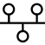


ADVANCED TOPICS
Deep Learning Deep Dive
Deep Learning, a specialized branch of Machine Learning, leverages artificial neural networks to learn complex patterns directly from data, driving breakthroughs in AI capabilities across various domains.
Neural Network Architecture
Backpropagation Algorithm
Convolutional Neural Networks (CNNs)
Recurrent Neural Networks (RNNs)
Comprises interconnected layers of "neurons" with activation functions, allowing complex hierarchical feature learning. Each layer processes information before passing it to the next.
The core training mechanism that adjusts network weights based on the error rate obtained in the previous epoch, effectively teaching the model to minimize prediction inaccuracies.
Designed for image and video processing, CNNs use convolutional layers to automatically and adaptively learn spatial hierarchies of features from input data, revolutionizing computer vision.
Tailored for sequential data like natural language and time series, RNNs have internal memory to process variable-length inputs and capture temporal dependencies between data points.
Transformer Models
A novel architecture dominating NLP, utilizing self-attention mechanisms to weigh the importance of different parts of the input data, enabling highly parallel training and superior performance.
1
Life is not Easy
16

Slide 19
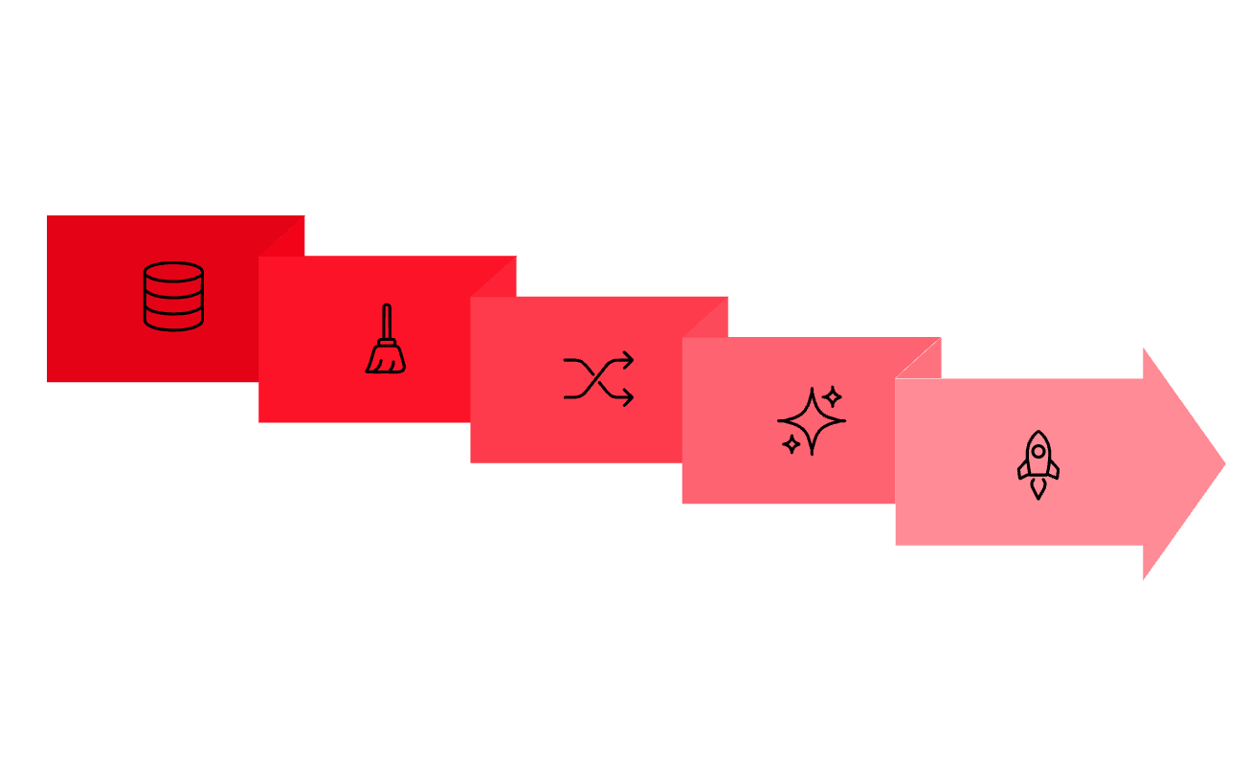





ESSENTIAL SKILLS
Data Preprocessing & Feature Engineering
Before any machine learning model can learn effectively, the raw data must undergo meticulous preparation. Data preprocessing is the critical first step, ensuring data quality, consistency, and suitability for algorithmic consumption. Neglecting this phase can lead to models that perform poorly, yield inaccurate insights, or fail to generalize to new data.
Raw Data
Transformation
Model-Ready
Data Cleaning: Involves handling missing values (imputation or removal) and identifying/mitigating outliers that can skew model training.
Normalization/Standardization: Scaling numerical features to a standard range or distribution prevents features with larger values from dominating the learning process.
Feature Engineering: The art of creating new input features from existing ones to improve model performance and capture underlying relationships more effectively. This often requires domain expertise and creativity.
Data Cleaning
Feature Engineering
1
Life is not Easy
17

Slide 20
Thank You
Life is not Easy

